Slide 1

WheelsUp

Slide 2
Introduction
Wheelsup is a web application that provides a complete solution to all your day-to-day car booking office running needs. Customers can book cars from their home. This system takes information from customers through filling their details.
This is available for 24x7. This system works online so allow anyone to book or rent a vehicle without any time restriction. This system allows the customer to board the vehicle at his choice of location, pay for the rental online and could provide valuable feedback for improvement in services. With the help of car rental system you can maximize the revenue by increasing your reach to customers. It automates manual procedures in an effective and efficient way.

Slide 3
PROJECT MODULES
The system includes 4 modules. They are:
1. Admin module
The admin is the overall controller of the system. Admin can add a car, manage booking car and rent, make calculation and generate billing details to the customer, payment process is managed, and can view the feedback.
2. User Module
User can view information of available car, booking car, easily get the car on rent and also give feedback. They also able to edit their profile and change password

Slide 4
3. Guest Module
Guests are the user who can view the contents of the system without registering into the site. If the guest user tries to rent a car the system will redirect to the registration page.
4. Car Owner Module
This user can rent their cars into the site and earn money. They can register in to this system, according to the renting of cars they will earn the profit.
5. Driver Module
Driver can register in to the system and can earn money by completing their targets.

Slide 5
Functionality performed by Admin
• Add Car:
The Admin can add the car so that the user can see the available cars and book the car.
• Manage Rent:
The Admin can manage the rent so that the user can see the rent and book the car.
• View Feedback:
The admin easily view the feedbacks and solve the query.
• Booking Details:
View Booking Details
• Status:
Manage Status of the car
• Approve:
Can Approve the user and car requests by verifying the documents

Slide 6
Functionality performed by User
• View Available Cars:
It is a system design especially for large, premium and small car rental business.
The user can view Available cars and user can book for that car.
• Booking Car:
The user can view Available cars and user can book for that car.
• Easily Get the Car on rent:
The Customer can easily get the car whenever they need to on the rent with use of this system.
• Give Feedback:
The customer will give the feedback to the admin.

Slide 7
• Rent payment:
Can pay the rent through the online.
Functionality performed by Car Owner
• Rent cars:
Car owner can rent their cars into the site. They will paid according to the renting of the car
• View Feedback:
The Car owner can easily view the feedbacks and solve the query.

Slide 8
Functionality performed by Driver:
• View Feedback:
The Driver can easily view the feedbacks and solve the query.
Existing system have only a renting of vehicles but here the users can rent their own cars and earn income

Slide 9
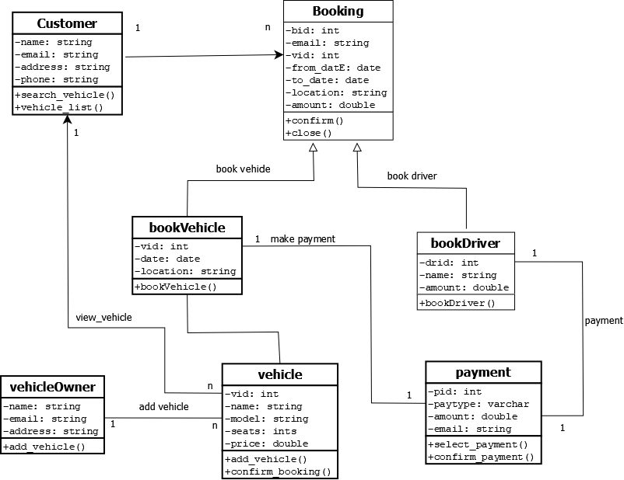
Class diagram

Slide 10
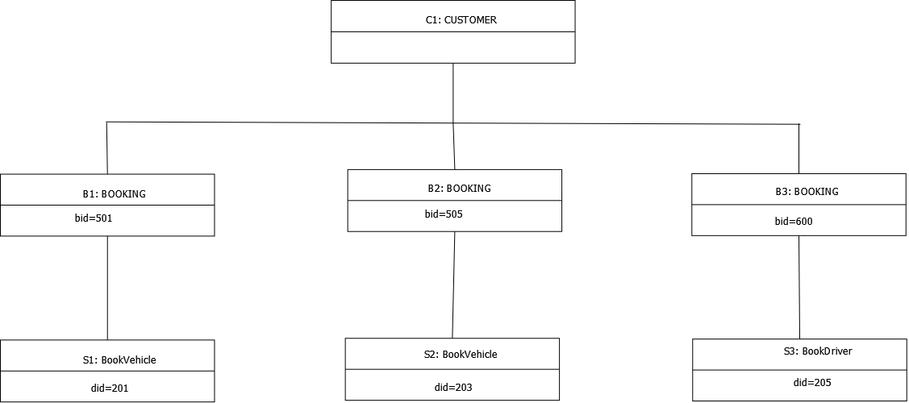
Object diagram

Slide 11
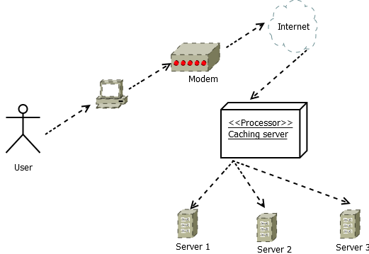
Deployment diagram

Slide 12
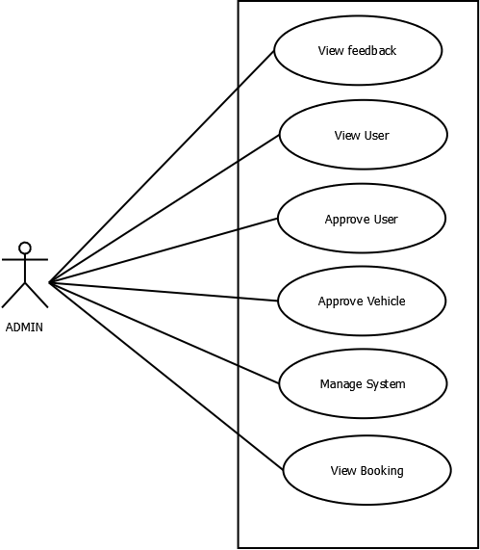
Use case diagram

Slide 13
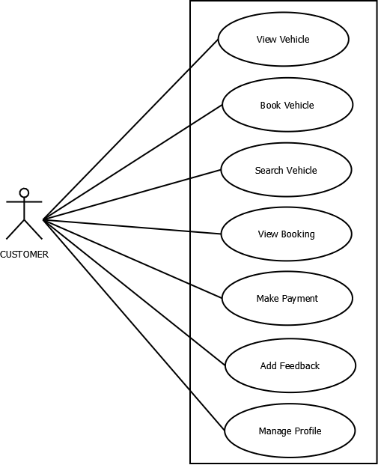

Slide 14
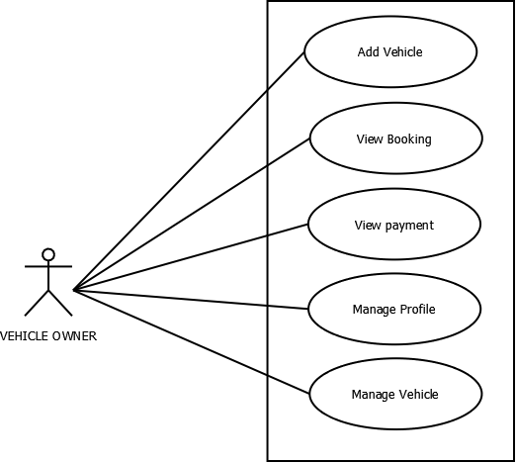

Slide 15
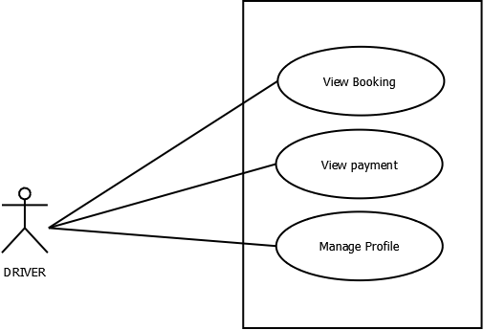

Slide 16
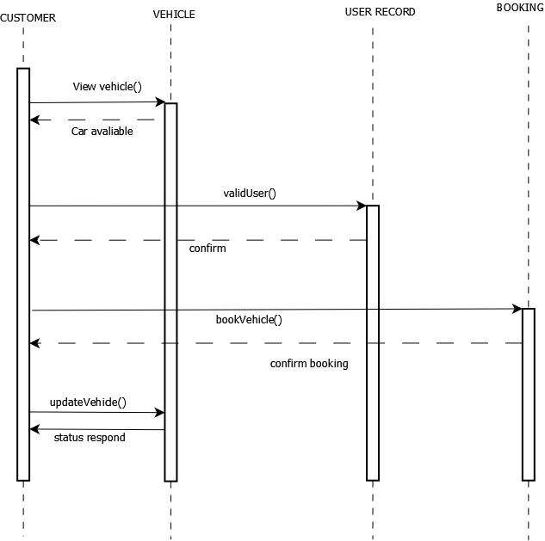
Sequence diagram

Slide 17
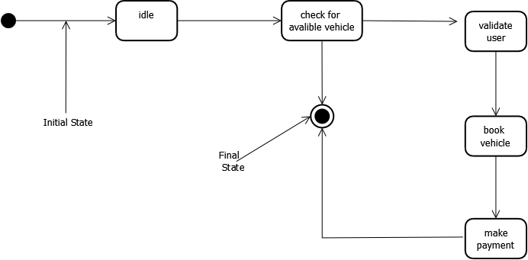
Statechart diagram

Slide 18
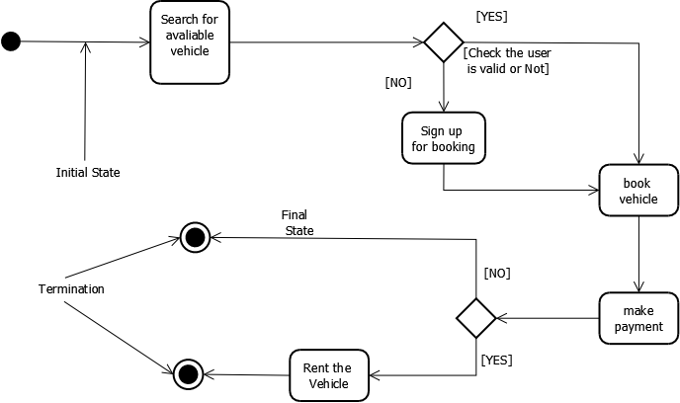
Activity diagram

Slide 19
Table No 1 :login
Primary key: id
Foreign key: rid
Field | Data Type | Keys | Description
id | int(10) | Primary Key | Login Id
rid | int(10) | Foreign Key | Registered User Id
email | varchar(60) |  | User Email Id
password | varchar(255) |  | Password
type | varchar(255) |  | Type of User
status | varchar(255) |  | Status of User

Slide 20
Table No 2: user
Primary key :uid
Field | Data Type | Keys | Description
uid | int(10) | Primary Key | User Id
fname | varchar(255) |  | First name
phone | varchar(255) |  | Phone no
adhar | varchar(255) |  | Aadhar No
gender | varchar(255) |  | Gender
place | varchar(255) |  | Place of User
prof_img | varchar(255) |  | Image of the User
did | varchar(10) |  | District Id

Slide 21
Table No 3: ownerreg
Primary key :uid
Field | Data Type | Keys | Description
oid | int(10) | Primary Key | Owner Id
oname | varchar(255) |  | First name
oaddress | varchar(255) |  | Owner Address
oemail | varchar(60) |  | Owner Email
omobile | varchar(255) |  | Mobile No
gender | varchar(255) |  | Gender
oadhar | varchar(10) |  | Aadhar No
oplace | varchar(255) |  | Place

Slide 22
Table No 4: driverreg
Primary key :did
Field | Data Type | Keys | Description
did | int(10) | Primary Key | Driver Id
dname | varchar(255) |  | First name
demail | varchar(60) |  | Driver Email
dmobile | int(20) |  | Mobile No
dgender | varchar(255) |  | Gender
imglicence | int(20) |  | Licence No
dplace | varchar(255) |  | Place
dprofile_img | varchar(255) |  | Image
age | int(20) |  | Age of driver
amount | int(20) |  | Per day amount

Slide 23
Table No 5 :state
Primary key :id
Field | Data Type | Keys | Description
id | int(10) | Primary Key | State Id
sname | varchar(255) |  | State name
Table No 6 :tbl_district
Primary key :did
Foreign key:id
Field | Data Type | Keys | Description
did | int(10) | Primary Key | District Id
id | int(10) | Foreign Key | State Id
dname | varchar(255) |  | District name

Slide 24
Table No 7 :tbl_otp
Primary key :oid
Field | Data Type | Keys | Description
oid | int(10) | Primary Key | OTP Id
email | varchar(60) |  | Email Id of User
otp | Int(10) |  | Created OTP
Table No 8:models
Primary key :bid
Foreign key: lid, carid
Field | Data Type | Keys | Description
mid | int(10) | Primary Key | Model Id
m_name | int(10) |  | Model Name
creation_date | varchar(60) |  | Created Date

Slide 25
Table No 9 :cars
primary key :cid
Foreign key:lid
Field | Data Type | Keys | Description
cid | int(10) | Primary Key | Car Id
lid | int(10) | Foreign Key | Login Id
model | varchar(60) |  | Model of the car
name | varchar(60) |  | Car name
millege | int(60) |  | Car millege
seats | int(60) |  | Car seats
aprice | int(60) |  | Security Deposit
rprice | int(60) |  | Rent Amount
fuel | varchar(25) |  | Fuel Type
ac | varchar(25) |  | Ac/Non Ac
music | varchar(25) |  | Music system
steering | varchar(25) |  | Power Steering or not
centerlock | varchar(25) |  | Central Lock or not
cimage | varchar(255) |  | Image of vehicle
regimage | varchar(255) |  | Verification document
regno | varchar(255) |  | Registration No
place | varchar(255) |  | Place
date | date |  | Date
cstatus | varchar(255) |  | Car status

Slide 26
Table No 9 :bookings
primary key :bid
Foreign key:lid,carid
Field | Data Type | Keys | Description
bid | int(10) | Primary Key | Booking Id
lid | int(10) | Foreign Key | Login Id
carid | varchar(60) | Foreign Key | Car Id
fromdate | date |  | Drop in date
todate | date |  | Drop off date

Slide 27
Table No 11 :tbl_bank
primary key :bankid
Field | Data Type | Keys | Description
bankid | int(10) | Primary Key | Bank id
bankname | varchar(255) |  | Bank name
cardtype | varchar(255) |  | Debit/Credit card
account_no | varchar(255) |  | Account Number
card_no | varchar(255) |  | ATM Card Number
month | varchar(255) |  | Expiry Month
year | varchar(255) |  | Expiry Yaer
cvv | int(11) |  | CVV
name | varchar(255) |  | Card Holder Name
status | int(11) |  | Status

